Slide 1

A W inning
Combination:
Medicare & The Right Medicare Supplement Insurance Plan
Your presenter today: Name,
Licensed Blue Cross and Blue Shield of Oklahoma Agent
MRK_SNSMEDSUPP2013
600734.1113
A Division of Health Care Service Corporation, a Mutual Legal Reserve Company, an Independent Licensee of the Blue Cross and Blue Shield Association
Notes:
Good <morning/afternoon/evening.> I am <NAME OF PRESENTER><TITLE>

Slide 2

Today’s Topics
Medicare Overview
Medicare Supplement Insurance Plan Overview
Blue Medicare Supplement Insurance Plan Options

Slide 3

When are you eligible for Medicare?
Age 65 or older
*Under 65 with certain disabilities
*Any age with End-Stage Renal Disease
(ESRD – permanent kidney failure
requiring dialysis or a kidney transplant)
*Only Plan A is available

Slide 4





What does Medicare cover?
Part A
Hospitalization
Insurance
Part B
Medical
Insurance
+
=
Original Medicare
Part D (Prescription Drug)
  You can choose to buy Medicare prescription
  drug coverage from a Prescription Drug Plan
Medicare Supplement Insurance (Medigap)
  A Medicare Supplement Insurance Policy can help cover costs not covered by Original Medicare
Notes:
Part A covers hospital insurance.
Part B helps cover medical services.
Part A and Part B are often referred to as Original Medicare.
Part D covers Prescription Drugs.
Medicare Supplement Insurance is also referred to as Medigap and can help cover costs not covered by Original Medicare.

Slide 5
Eligibility Facts
Some people get Part A and Part B automatically
  If you are already getting Social Security or Railroad Retirement Board benefit checks
  Medicare ID Card mailed about 3 months before your birthday or
  your 25th month of disability benefits from Social Security
If you are covered under a group health plan:
  Either your or your spouse’s current employer;
  you may delay enrolling in Medicare Part B
  You can sign up for Medicare Part B during the 8-month
  period that begins the month the employment ends, or the
  group health plan coverage ends, whichever happens first
Notes:
When you become eligible for Medicare you are automatically enrolled in Part A for FREE. In order to get Part B, you must sign up for it.

Slide 6

Part A (Hospital Insurance)
Covered Benefits:
Inpatient Hospital Stays
Inpatient Skilled
Nursing Facility Care
Home Health Services
Hospice Care
Blood
Note: Part A is FREE for most people

Slide 7

Part B (Medical Insurance)
Covered Benefits:
Doctor’s Care & Surgery
Outpatient care
Emergency Room Visits
Lab Tests and X-rays
Home Health Care
Durable Medical Equipment
Other Medically Necessary
Services & Supplies
Preventive Benefits
Note: Part B has a monthly premium that is deducted from your Social Security check
Notes:
Part B has a monthly premium that is deducted from your Social Security check. If you do not receive social security, you will need to pay this premium on your own.

Slide 8
Medicare Part B
Enrollment Periods
Days | Initial | General | Special
Who is eligible? | Those turning 65 | Those who miss the Initial Enrollment Period | Those who have employer or union benefits or prior Part B coverage
When is it? | 7-month window: 3 mos. prior to, the 65th birthday month, and 3 mos. after the 65th birthday month | Jan 1 – March 31 of each year for coverage beginning July 1 | 8 months starting on the date employment or group coverage ends
What if I miss it? | 10% penalty for each year you’re late in enrolling | 10% penalty for each year you’re late in enrolling | Must enroll while employed or within 8-month window
Notes:
You can sign-up for Part B during the initial enrollment period, the general enrollment period or the special enrollment period.

Slide 9

Medicare Supplement
Insurance Plans

Slide 10
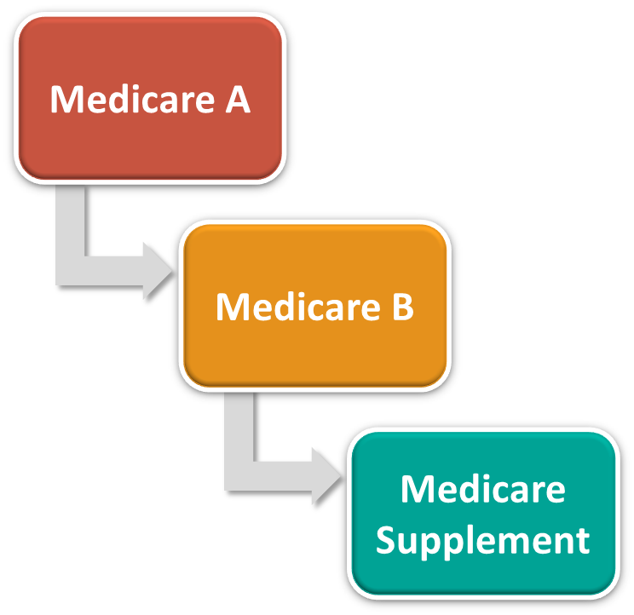

What is a Medicare Supplement Insurance Plan?
A Medicare Supplement Insurance Plan is private health insurance that is designed to supplement Original Medicare.
This means it helps pay some of the
health care costs that Original Medicare doesn’t cover, such as:
copayments
coinsurance
deductibles
Notes:
A Medicare Supplement Insurance Plan policy is health insurance sold by private insurance companies and is regulated by Medicare. Medicare Supplement Insurance Plans help pay some of the costs that Original Medicare doesn't cover, such as copayments, coinsurance, and yearly deductibles.

Slide 11
Requirements to Buy a Medicare Supplement Insurance Plan
You need both Medicare Part A and Part B
You have a “Guaranteed Issue” right if
insured during your first six months of
Medicare eligibility

Slide 12


Benefits Overview:
Medicare Parts A & B
Medicare Supplement Insurance Plans

Slide 13
Medicare Costs
Medicare Benefits | You may pay
Part A Deductible | $1,216 per benefit period
Part A Hospital Days 61-90 @ $304 a day | $9,120 / 30 days
Part A Hospital Days 91-150 @ $608 a day | $36,480 / 60 days
Part A Skilled Nursing Facility Days 21-100 @ $152 a day | $12,160 / 80 days
Part B Annual Deductible | $147
Part B Medical Insurance | Generally you pay 20% of the Medicare-approved amount after the yearly Part B deductible is met
Excess Charges (any amount not paid by Medicare) | No coverage; you pay 100% of excess charges
Total Uncovered Expenses that could be payable by YOU | *$58,976 *Based on an unusual or unique claim
Notes:
Without a Medicare Supplement In

Slide 14
Medicare Supplement Insurance Costs
Medicare Benefits | WITHOUT a Medicare Supplement Insurance Plan Plan You May Pay | WITH a Plan F (most popular plan), You Pay *Based on 2012 BCBSTX Medicare Supplement Insurance Plan sales
Part A Deductible | $1,216 per benefit period | $0
Part A Hospital Days 61-90 @ $304 a day | $9,120 / 30 days | $0
Part A Hospital Days 91-150 @ $608 a day | $36,480 / 60 days | $0
Part A Skilled Nursing Facility Days 21-100 @ $152 | $12,160/ 80 days | $0
Part B Annual Deductible | $147 | $0
Part B Medical Insurance | Generally you pay 20% of the Medicare-approved amount after the yearly Part B deductible is met | $0
Excess Charges | No coverage; you pay 100% | $0
Total Uncovered Expenses that could be payable by YOU | *$58,976 *Based on an unusual or unique claim | $0

Slide 15
Other Medical Expenses
 | What Medicare Pays | Medicare Supplement Insurance Plan F (most popular plan***) Pays | You Pay
Emergency Care in a Foreign Country* (Medically Necessary) | $0 | 80% of eligible expenses up to $50,000 lifetime maximum** | $250 deductible, 20% and amounts after the $50,000 lifetime maximum
* In most situations, Medicare won’t pay for health care or supplies you get outside the United States.
** You are responsible for any remaining charges not covered by the Foreign Travel Emergency Coverage.
*** Based on 2011 Blue Cross Blue Shield of Oklahoma Medicare Supplement Insurance Plan sales.

Slide 16
Blue Cross and Blue Shield of Oklahoma
Medicare Supplement
Insurance Plans

Slide 17

Blue Medicare SupplementSM
Insurance Plan Options
Standard
4 standardized plans: Plan A, Plan F, High Deductible Plan F,
and Plan N
Competitive
monthly premiums
*Blue Plan65 Select
2 Plans: Plan F and Plan N
Use any of the hospitals in our Blue Plan65 Select Hospital Listing (not an HMO)
Lower monthly premiums
Note: Blue Plan65 Select is available
only in certain Oklahoma counties
*Network Restrictions Apply
Notes:
Blue Plan65 Select is available as an option only with Plan F and Plan N.
If you do not use one of the hospitals, in our Blue Plan65 Select Hospital listing, for your non-emergency admissions, you agree to pay the <$1,184> Part A deductible and any non-covered charges.
Only certain hospitals are network providers under this policy.
Check with your doctor to determine if he or she has admitting privileges at the network hospital.
If he or she does not, you may be required to use another doctor at the time of hospitalization or, if you still use a non-network hospital, you must pay the Part A deductible and any non-covered charges.
This option is available in specific geographic areas only and you must live within a 25-mile radius of a hospital in the Blue Plan65 Select Network to qualify.

Slide 18

What is Blue Plan65 Select?
Blue Plan65 Select is a money-saving Medicare
Supplement Insurance option that is NOT an HMO
Offers the same benefits as our
standard option, but costs less
To qualify for Blue Plan65 Select, you must live
in the approved service area within 25 miles
of a Blue Plan65 Select network hospital
With Blue Plan65 Select, you are covered for
urgent and emergency care at any hospital
    Blue Plan65 Select Plan requires that you use BCBSOK contracting Blue Plan65 Select hospitals for non-emergency admissions to receive coverage for the Medicare Part A deductible. In an emergency, the $1,184 deductible is covered
    at any hospital from which you receive care. Note: Blue Plan65 Select is available only in certain Oklahoma counties.
Notes:
Blue Plan65 Select is an option available with two of our Medicare Supplement insurance plans. This option helps you save on premiums when you agree to use one of the hospitals in our Blue Plan65 Select Network for non-emergency elective admissions. You get the same solid benefits as our "standard" plans, but your premiums will cost less.

Slide 19
*High-Deductible Option Plan F
Annual deductible has to be met before the plan pays anything
  Also has a Foreign Travel Emergency deductible
Has lower premiums
Out-of-pocket costs may be higher
*A type of Medicare Supplement Insurance Plan

Slide 20

Medicare Supplement Insurance Plan
Key Points
Must have Medicare Part A and Part B
Must continue to pay Medicare Part B premium
You must pay the insurance company a monthly premium for your Medicare Supplement Insurance Plan
You cannot have a Medicare Advantage Plan and a Medicare Supplement Insurance Plan
Enrolling in a Medicare Supplement Insurance Plan is optional
  Each policy covers one person
  Spouses can each pick a different plan
  to match their individual coverage needs

Slide 21

Why choose a Blue Medicare Supplement Insurance Plan?

Slide 22

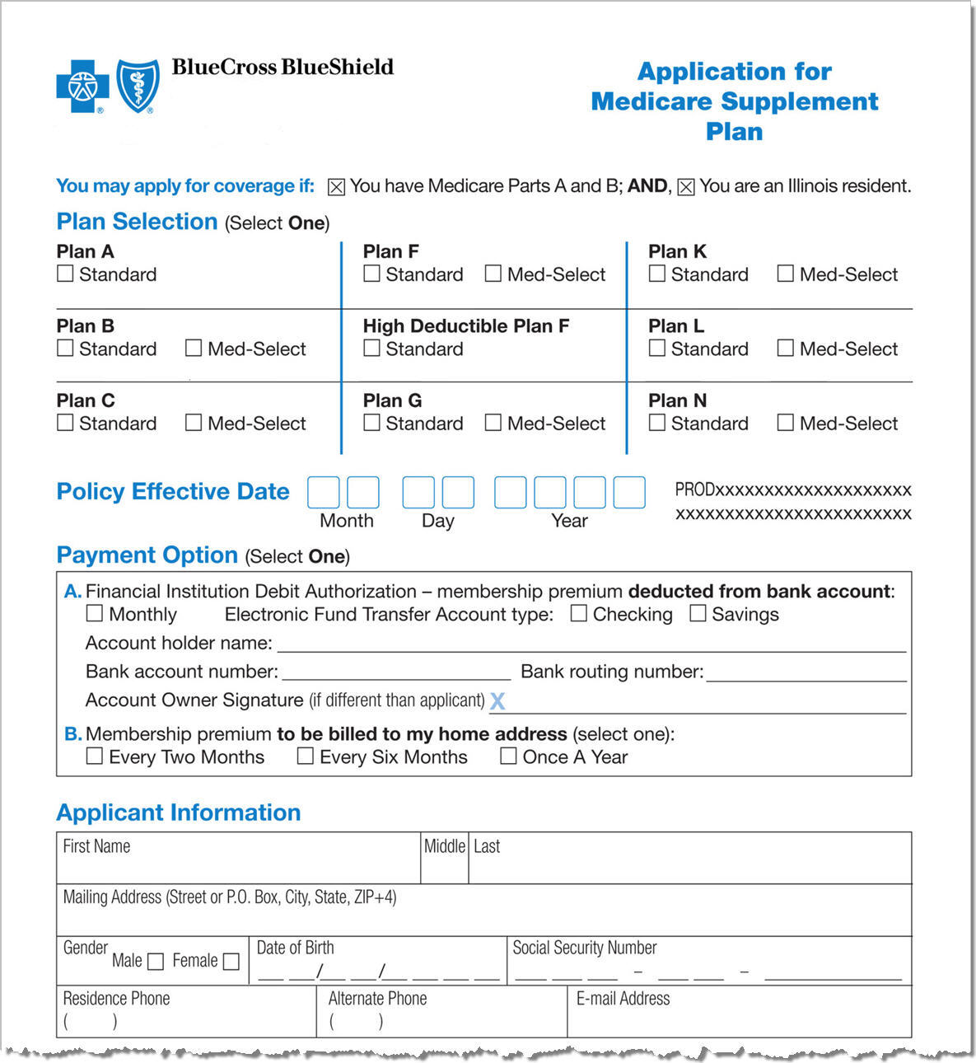
Service Begins the Moment you Enroll
Online www.mybluemedsupp.com – 24/7
By Phone 1-877-822-4855
8 a.m. – 8 p.m., Central Time, Monday – Friday
By Mail – You can download an application
form online or call us for an information kit
Locate a Licensed Authorized
Independent Insurance Agent at www.bcbsok.com/medicareagents

Slide 23

Taking Service a Step Further
Blue Access for MembersSM (BAM)
  Wellness tools and content
  www.bcbsil.com/bam
Education
  LifeTimes member newspaper
  Service in the Neighborhood
    Seminars
    Health Fairs
    Community Events
    Visit www.bcbsok.com/medicare/seminars

Slide 24

Thank You!
The best compliment you can give us is a referral; if you know anyone who needs assistance with selecting a Blue Cross and Blue Shield of Oklahoma Medicare Supplement Insurance Plan, please fill out the referral forms or take our business cards.
Thank you,
Field Representative

Slide 25
Additional Information
  * 97% approval rating for Blue Medicare Supplement Insurance members in
  Oklahoma. Source: Over 65, BCBSOK, member loyalty survey, September 30, 2012,
  12-month rolling average.
Blue Cross and Blue Shield of Oklahoma is a Division of Health Care Service
Corporation, a Mutual Legal Reserve Company, an Independent Licensee of
the Blue Cross and Blue Shield Association.
  Blue Cross and Blue Shield of Oklahoma Medicare Supplement Insurance plans
  are not connected with or endorsed by the U.S. Government or the federal
  Medicare program.

